Slide 1
Detecting Fraud in United States Healthcare System Ann Chavarria, David Lederer, Iain McKone, Monika Sharma
Notes:
This is the slide where you actually SAY your 1-2 sentence elevator pitch. Engage your audience!!

Slide 2
Outline
Problem
Solution
Data + Model
Demo
MLE Stack
Conclusions (and lessons learned)
Future Work

Slide 3

Problem
Healthcare fraud is a serious white-collar crime in US
Results in increased premiums or pose harm to beneficiaries
Scale
According to National Health Care Anti-Fraud Association, ~$300 billion is lost to fraud in US
Example
14 people – including medical doctor, owners of laboratories, pharmacies, and home health agency – were charged in multiple Covid-related fraud schemes
Bilked consumers and insurers out of $143 million
Source: https://www.cnbc.com/2021/05/26/doj-charges-14-people-in-alleged-health-care-fraud-related-to-covid-19.html
Notes:
Specify what Problem is being solved, and ensure that everyone is in agreement as to Why that’s a problem.

Slide 4




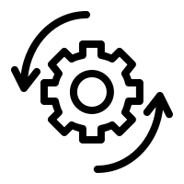
Solution
Use ML algorithms to automate claims data analysis and identify patterns of anomalies
Anomalies include claims for services that were never rendered
Services billed at inflated prices
Use NLP to detect inconsistent billing codes
Helps insurers to settle genuine claims quicker
Notes:
Specify what Success looks like, and for what Audience.

Slide 5
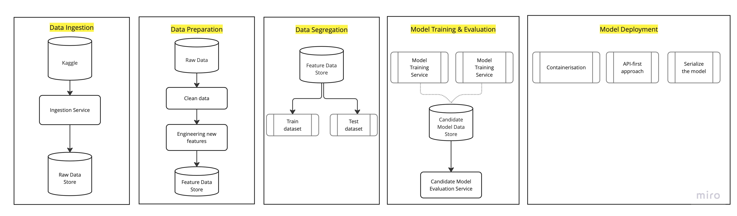
Data Lineage
Kaggle: https://www.kaggle.com/code/rohitrox/medical-provider-fraud-detection/data

Slide 6


Modeling
Supervised Technique
Unsupervised Technique
Create mapping function from training data
Extracts knowledge from large datasets
Logistic Regression
Support Vector Machines
XGBoost
TPOT
Isolation Trees
K-means clustering
Auto-encoders

Slide 7

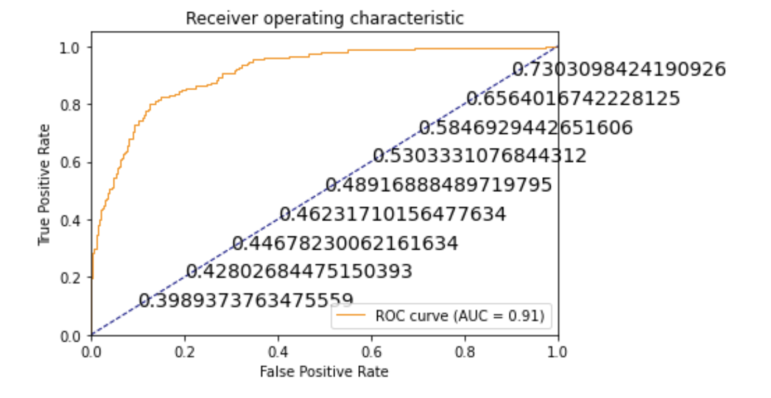
Model Evaluation
ROC-AUC curve based on XGBClassifier using TPOT
F1 Score | 0.59
Accuracy | 0.91
Recall | 0.61
Precision | 0.57

Slide 8
Learnings so far
Kaggle dataset is based on Medicare/Medicaid insurer.
Fraud is an organized crime which involves peers working together to create fraudulent transactions of claims
Creating additional features was extremely important to
Improve model accuracy
Helps reduce over-fitting
Importance of features that help explain model predictability:
Amount of insurance claim reimbursed, per provider– 8%
Amount of insurance claim reimbursed, per attending physician – 7%
Amount of insurance claim reimbursed, per operating physician – 6%
Amount of insurance claim reimbursed, per claim diagnosis – 4%

Slide 9

Demo
… & screen share well!

Slide 10
Future Work
Use the same dataset without labels to train unsupervised models

Slide 11
Thank You! Questions?

